Slide 1
MERN STACK
MERN stack basis and project setup

Slide 2
Web Development
Web development refers to the creating, building, and maintaining of websites.
It includes aspects such as web design, web publishing, web programming, and database management.
It is the creation of an application that works over the internet i.e. websites.

Slide 3
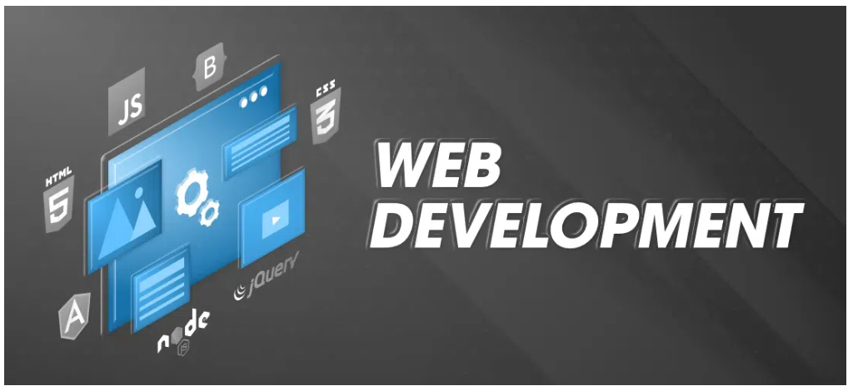

Slide 4
Web Development can be classified into two ways
Frontend Development
The part of a website where the user interacts directly is termed as front end. It is also referred to as the ‘client side’ of the application.
Backend Development
Backend is the server side of a website. It is part of the website that users cannot see and interact with. It is the portion of software that does not come in direct contact with the users. It is used to store and arrange data.

Slide 5
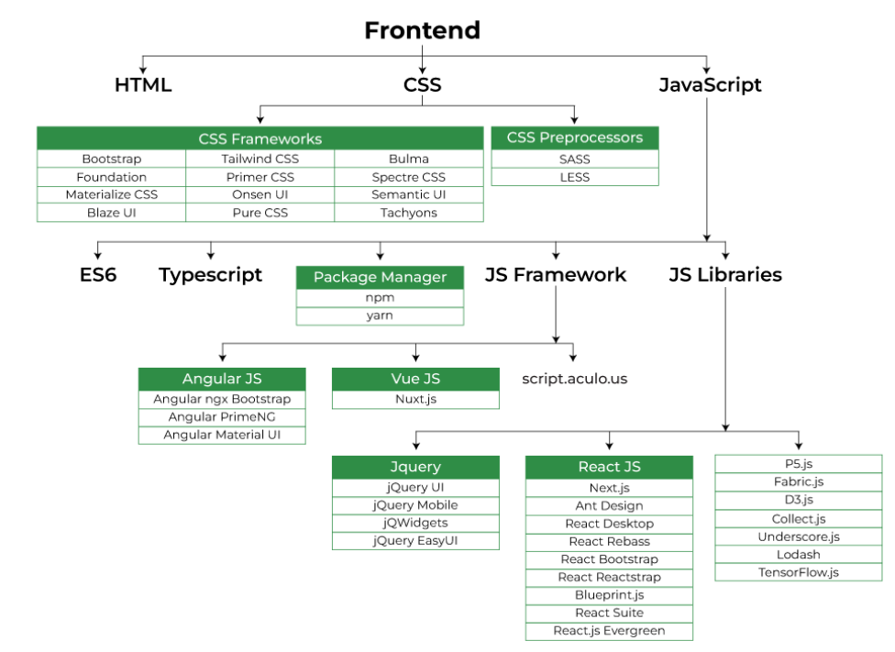

Slide 6
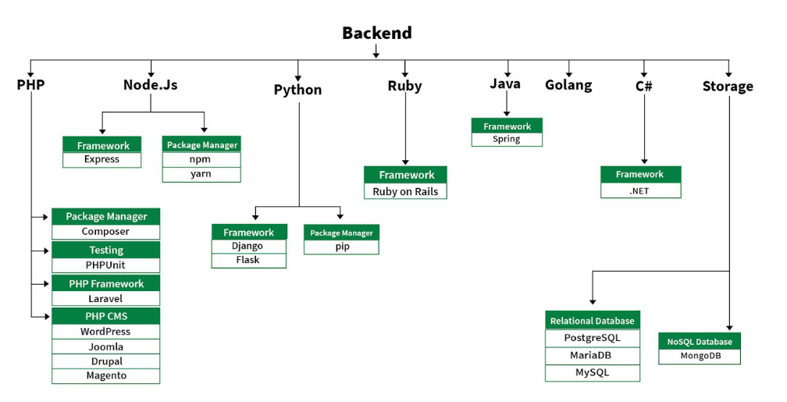

Slide 7
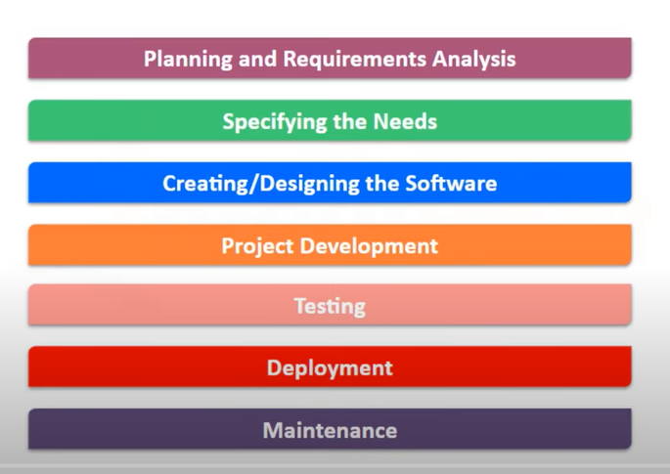
Development Steps

Slide 8
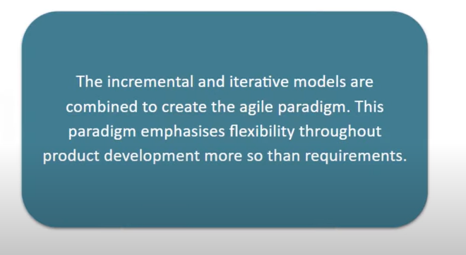
Agile Model

Slide 9
Sprints
Project is divided into units
Number of features increases with each build , upcoming update expands on earlier feature.
Sprints are the term used in agile for iteration
Sprints lasts about 2 to 4 weeks
Ends by product owner after verifying
Customer feedback is used to make improvements and following sprint will focus on his recommendations and enhancements

Slide 10
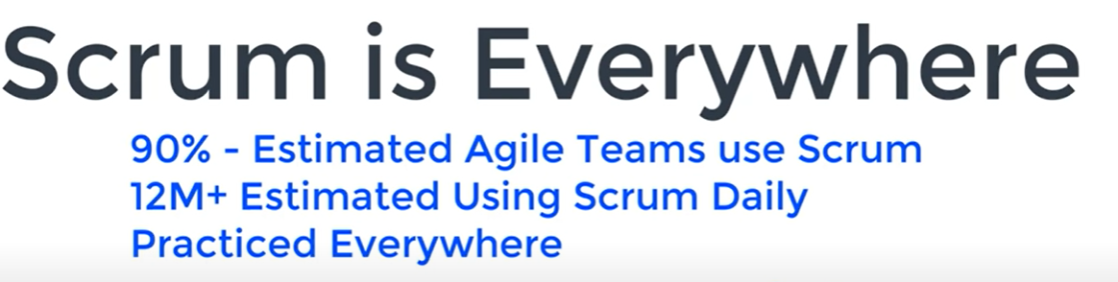
SCRUM – agile framework

Slide 11
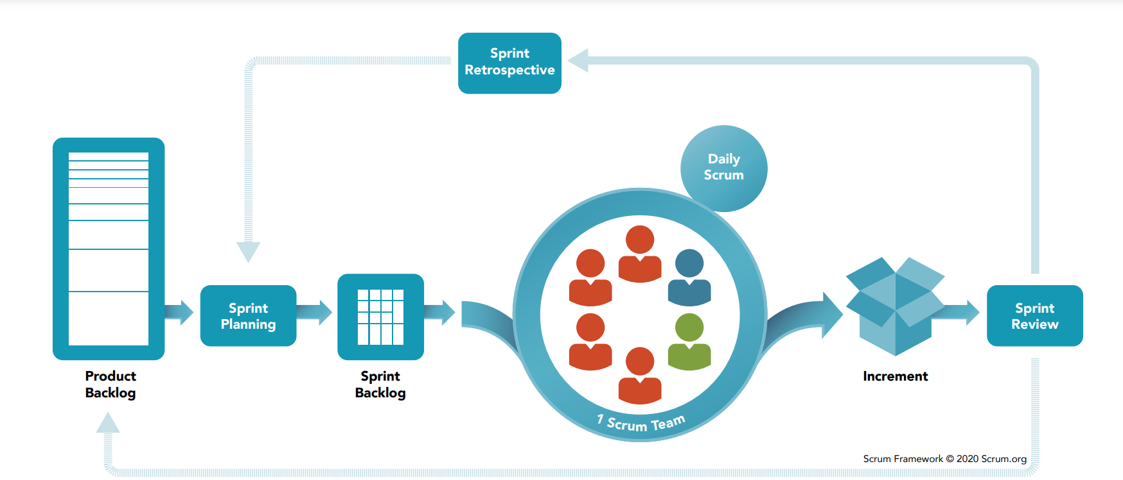
Scrum Framework

Slide 12
Client Server Architecture
Machine that offers some service – server
File server, print server, webserver
Takes request and gives u response after processing
Machine which provides u webpages – webserver
Grouping of webpages is called website
Every service have their own port number and own protocol

Slide 13
Computing and networking
File service (FTP protocol)
Webserver (HTTP protocol) – eg tomcat 8080

Slide 14
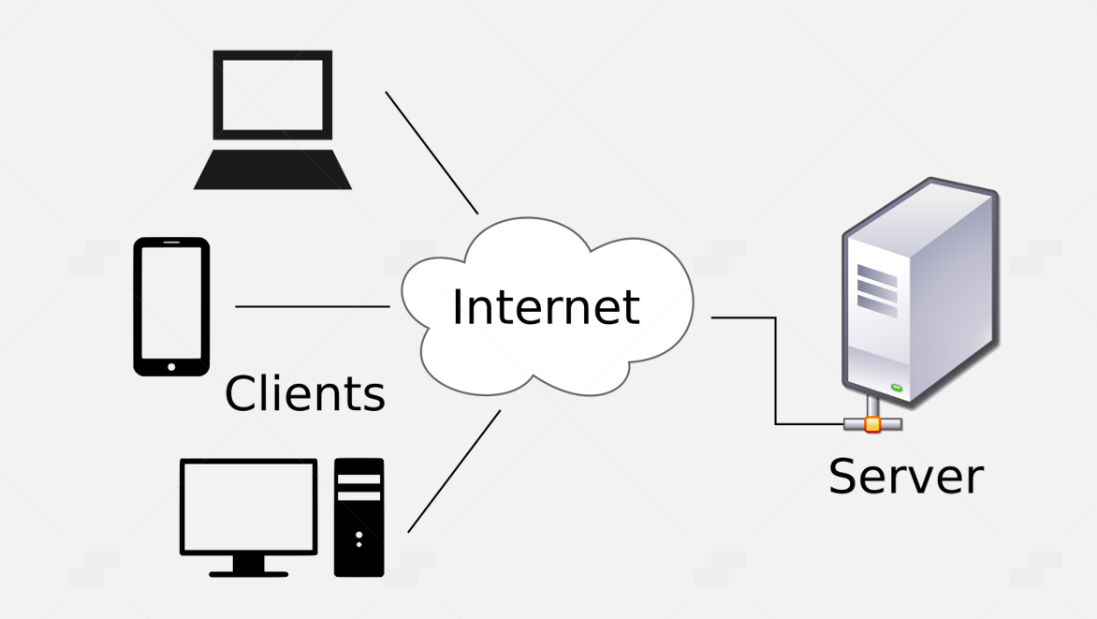
Client-server

Slide 15
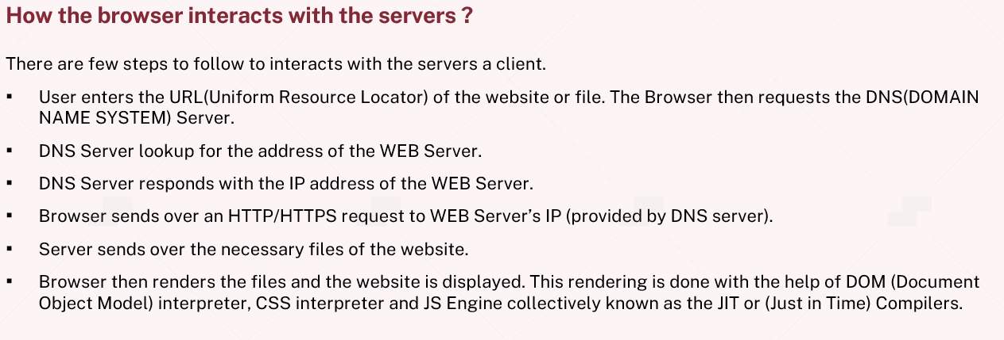
How Browser interacts with servers

Slide 16
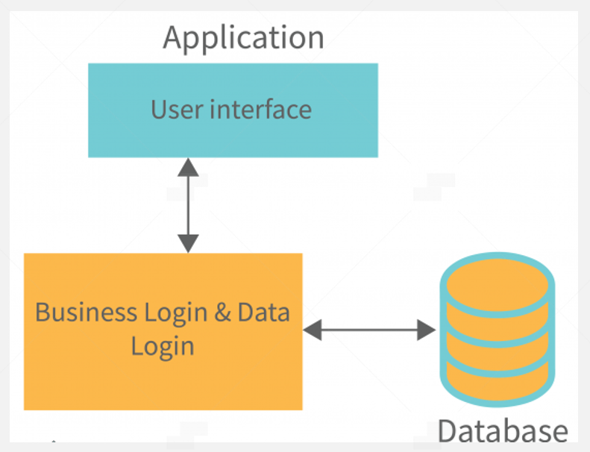
Application Flow

Slide 17
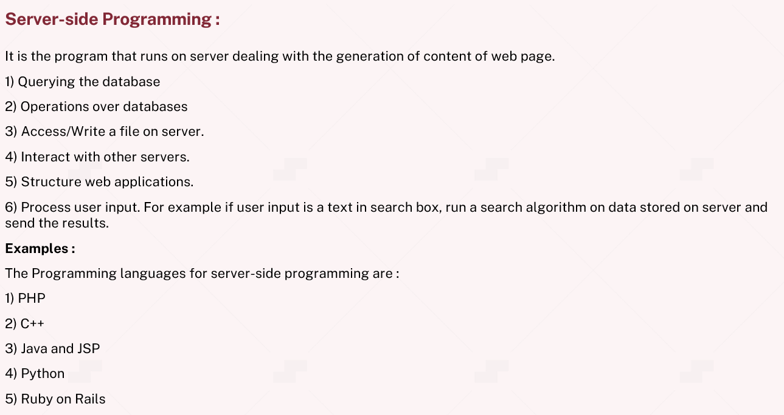
Server-side Programming

Slide 18
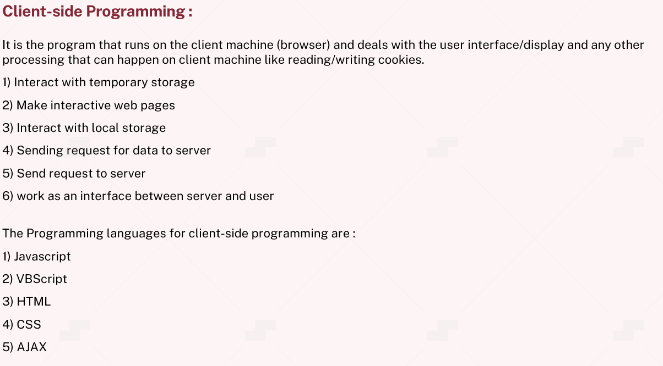
Client-side programming

Slide 19
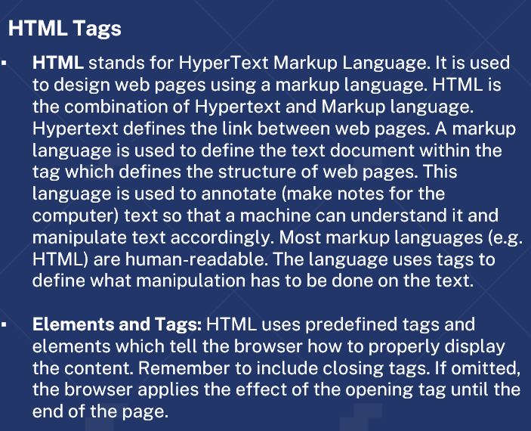
HTML Tags

Slide 20
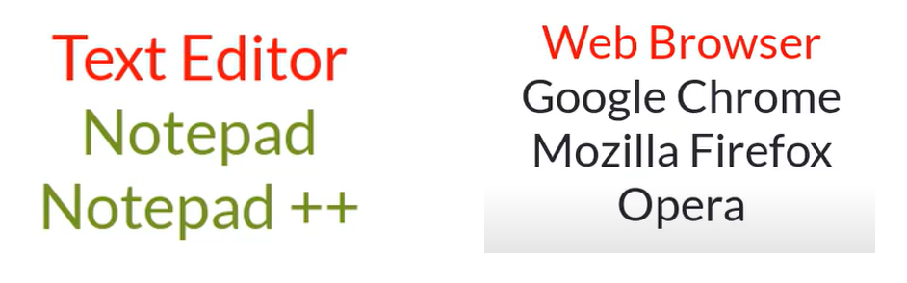
Code Editors

Slide 21
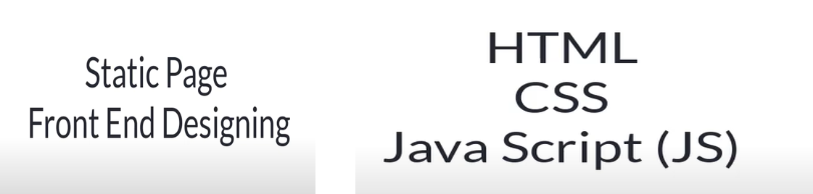
Design

Slide 22
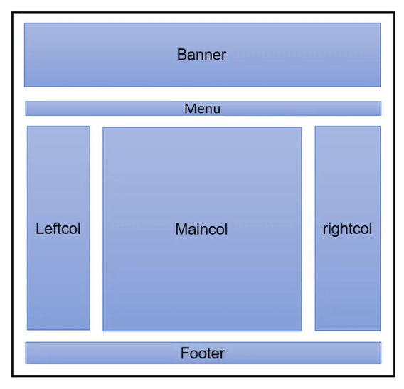
Layouts

Slide 23
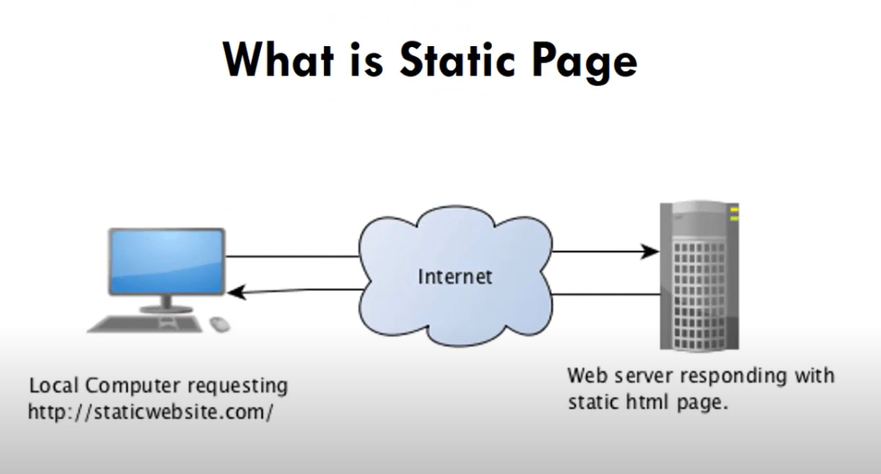
Static page

Slide 24
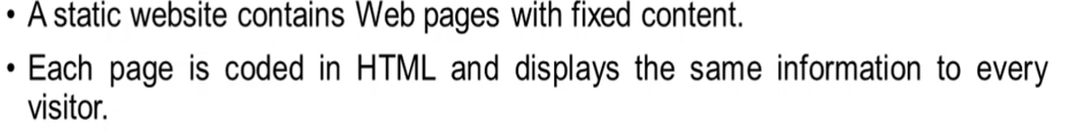
Static page

Slide 25
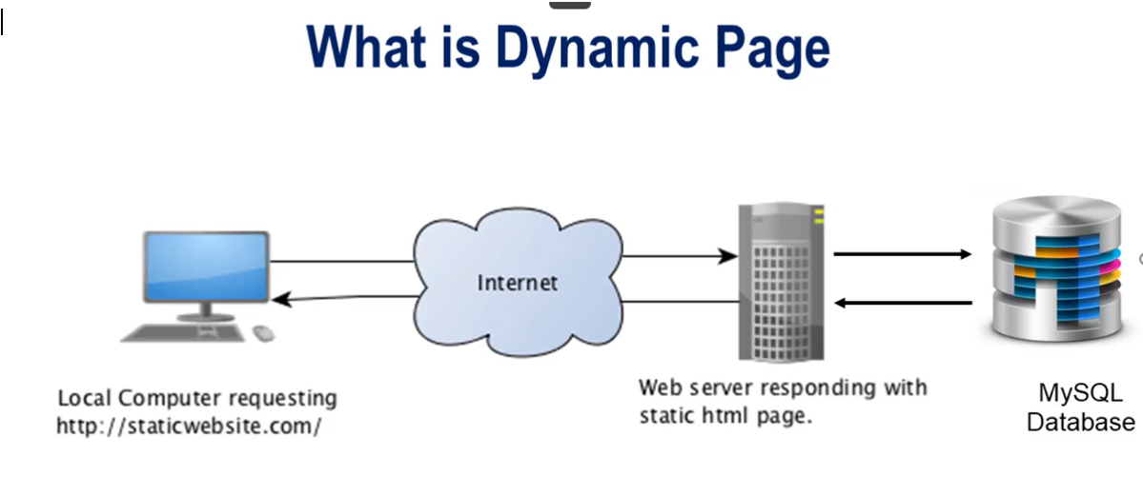
Dynamic Page

Slide 26
Server-side page

Slide 27
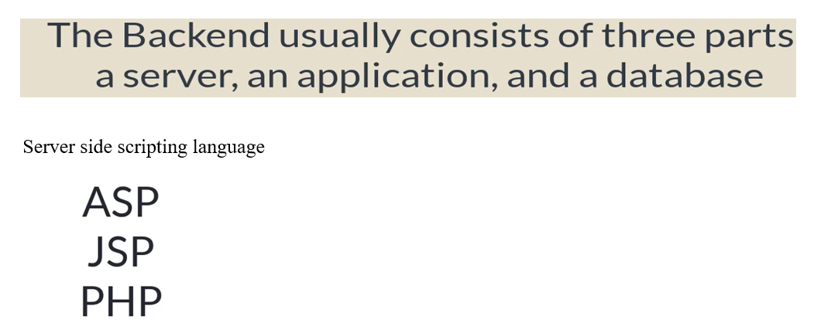
Backend

Slide 28
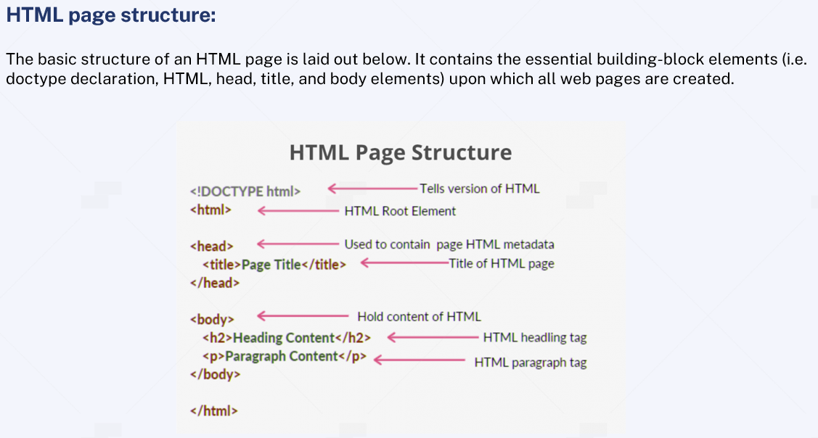
HTML page structure

Slide 29
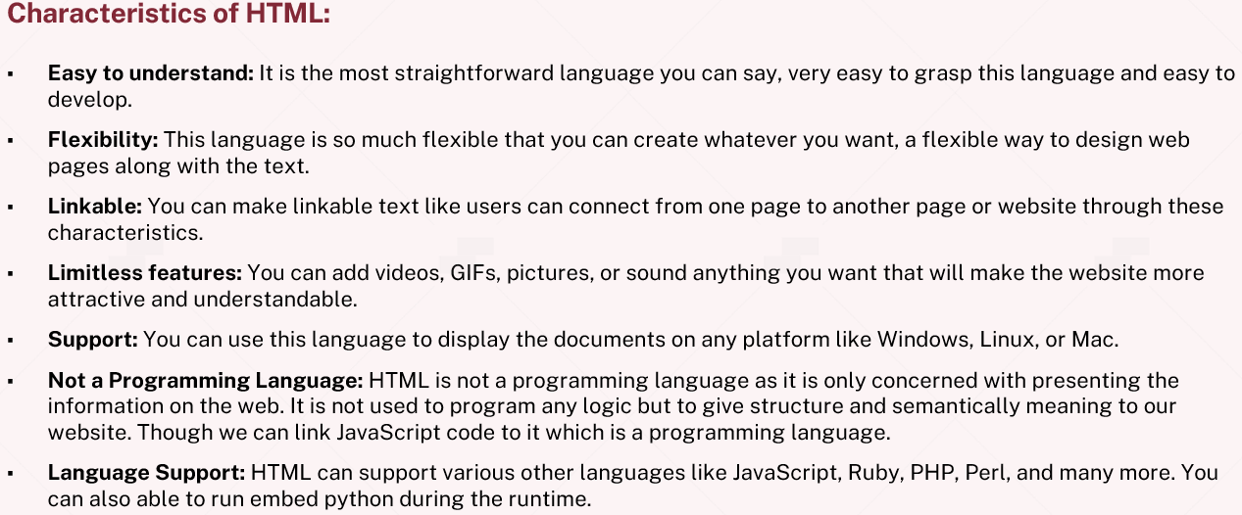
Characteristics of HTML

Slide 30
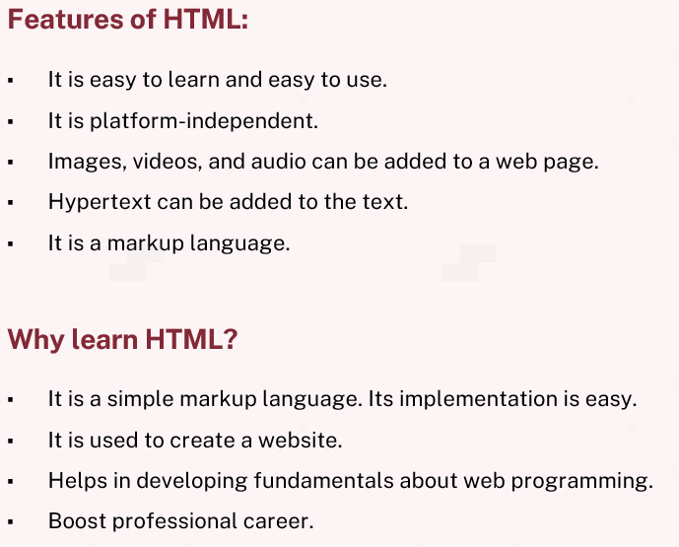
Features of HTML

Slide 31
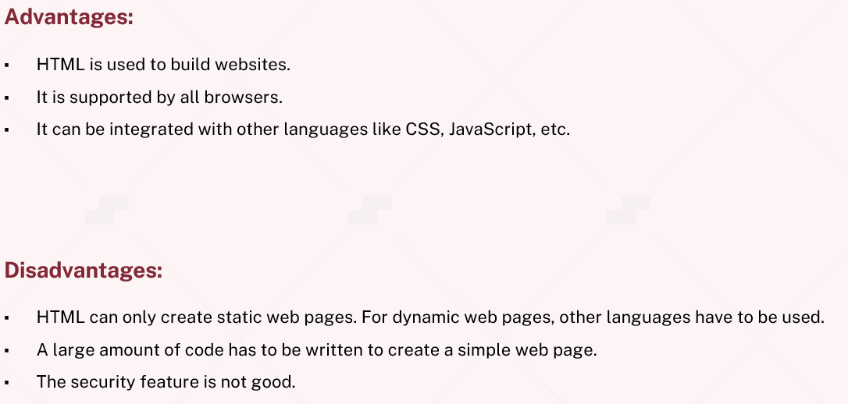
Advantages and Disadvantages

Slide 32
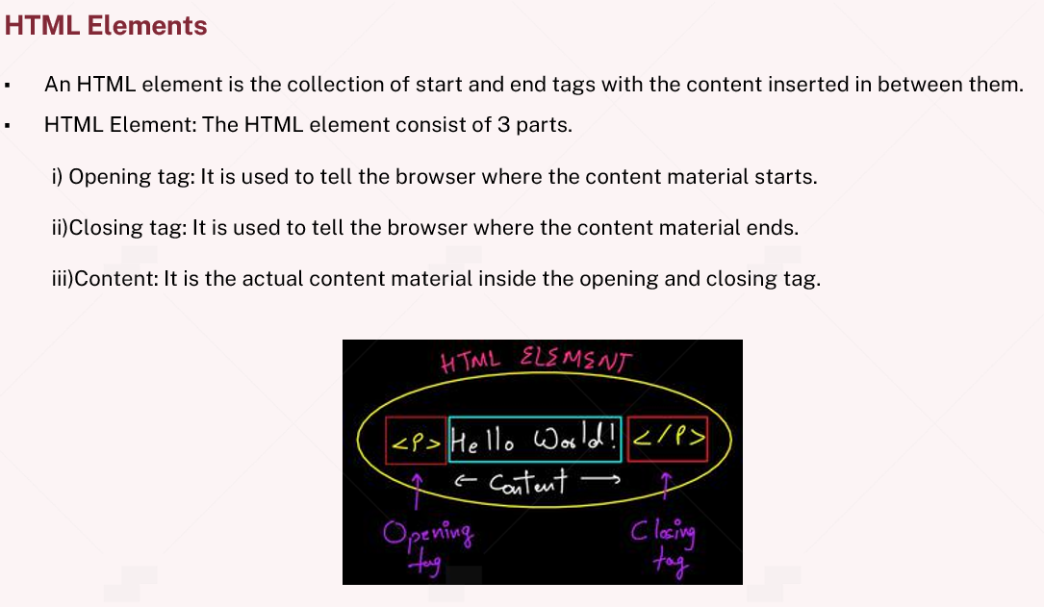
HTML Elements

Slide 33
Basics of HTML
HTML (Hypertext Markup Language):
HTML is the standard markup language used to create the structure of web pages. It consists of a series of elements that wrap content to define its structure. Here are some essential HTML elements:
1. HTML Document Structure:
<!DOCTYPE html>
<html lang="en">
<head>
<meta charset="UTF-8">
<meta name="viewport" content="width=device-width, initial-scale=1.0">
<title>My Web Page</title>
</head>
<body>
<!-- Content goes here -->
</body>
</html>
2. Headings
<h1>This is a Heading 1</h1>
<h2>This is a Heading 2</h2>
<!-- ... -->
<h6>This is a Heading 6</h6>

Slide 34
3. Paragraphs
<p>This is a paragraph.</p>
4. Lists
<ul>
<li>Item 1</li>
<li>Item 2</li>
</ul>
<ol>
<li>Item 1</li>
<li>Item 2</li>
</ol>
5. Links
<a href="https://www.example.com">Visit Example.com</a>
6. Images
<img src="image.jpg" alt="Description">

Slide 35
CSS (Cascading Style Sheets):
CSS is used to style the presentation of HTML elements. It describes how elements should be displayed on the screen, in print, or even spoken. Here are some basic CSS concepts:
Selectors and Styles
body {
font-family: 'Arial', sans-serif;
background-color: #f0f0f0;
}
h1 {
color: blue;
}
Box Model
.container {
display: flex;
justify-content: space-between;
}

Slide 36
3. Flexbox
.container {
display: flex;
justify-content: space-between;
}
4. Responsive design
@media screen and (max-width: 600px) {
body {
font-size: 14px;
}
}
JavaScript:
1. Variables
let name = ‘John’;
2. Data types:- String, Number, Boolean, Array, Object.
let age = 25;
let isStudent = true;
let colours = ['red', 'green', 'blue'];
let person = { firstName: 'John', lastName: 'Doe' };

Slide 37
3. Functions
function greet(name) {
return 'Hello, ' + name + '!';
}
let message = greet('Alice');
4. Conditionals
if (age >= 18) {
console.log('You are an adult.');
} else {
console.log('You are a minor.');
}

Slide 38
CMS (Content Management System) Concepts:
A Content Management System is a software application that allows users to create, manage, and modify digital content.
Building a CMS (Content Management System) with the MERN (MongoDB, Express.js, React, Node.js) stack involves creating a system that allows users to manage and update content easily. Here is a high-level overview of the steps involved:
Backend (Node.js and Express.js)
Set Up Node.js and Express.js:
Install Node.js if not already installed.
Create a new Node.js project using npm.
Connect to MongoDB:
Use Mongoose or the official MongoDB driver to connect to your MongoDB database.
Create models for the data you want to manage (e.g., pages, articles).
Create API Endpoints:
Build RESTful API endpoints to handle CRUD (Create, Read, Update, Delete) operations for your content.
Example endpoints might include /api/pages and /api/articles.
Implement Authentication (Optional):
If users need to log in to manage content, implement user authentication.
You can use libraries like Passport.js for authentication.
Handle File Uploads (Optional):
If your CMS involves media content, implement a mechanism for users to upload and manage files.
Consider using a library like Multer for handling file uploads.

Slide 39
Frontend (React)
Set Up React App:
Use Create React App or set up your React project manually.
Create Components:
Build React components for managing different types of content (e.g., pages, articles).
Use state and props to manage data and communication between components.
Implement CRUD Operations:
Create forms and components to add, edit, and delete content.
Use AJAX or fetch to communicate with your backend API.
Integrate with Backend API:
Make API requests to fetch and update content data.
Update the UI based on the responses from the backend.
Routing:
Implement client-side routing for different sections of your CMS.
You can use React Router for this purpose.
User Authentication (Optional):
If you have implemented user authentication on the backend, create protected routes and components that require authentication.
Putting It All Together
Run Both Servers
Test and Debug
Deployment
Security Considerations

Slide 40
Development Environment Setup

Slide 41
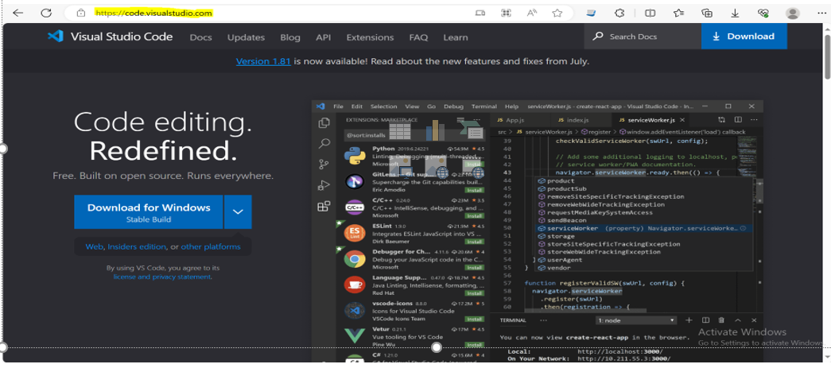
Install visual studio for React

Slide 42
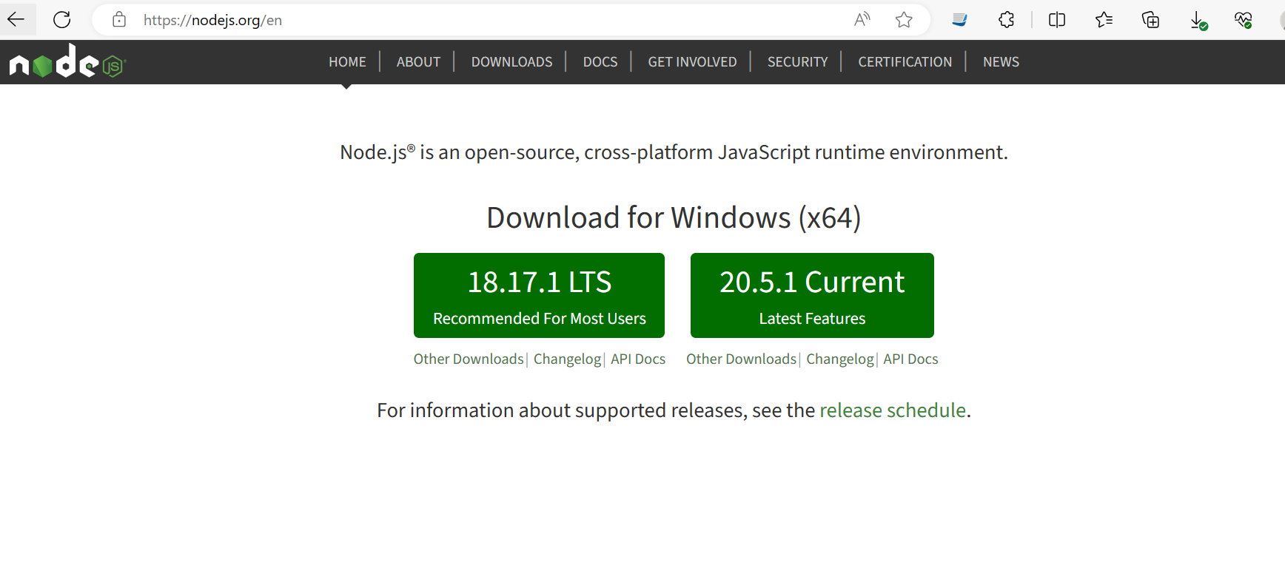
Node

Slide 43
Steps to create react app
Create new directory
Open vs code
Open terminal
npx create-react-app client(app name)
npm init react-app client(app name)
Notes: if npx is not working try this command
npm install –g create-react-app

Slide 44
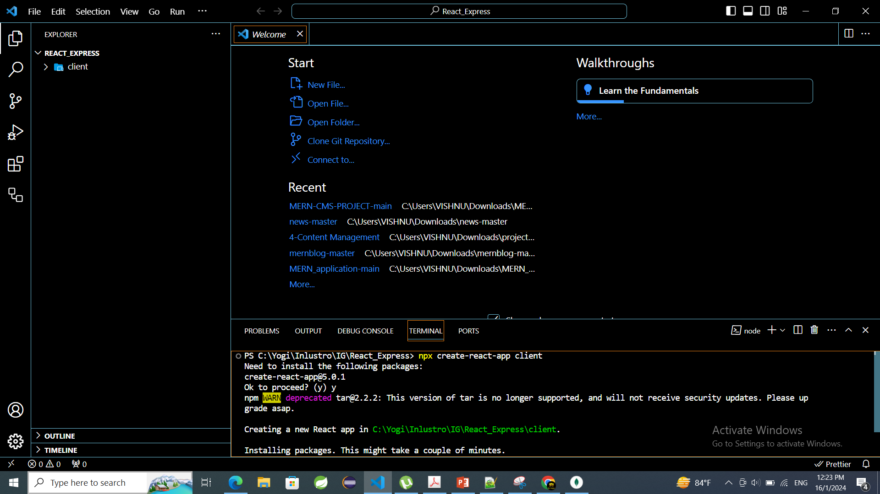

Slide 45
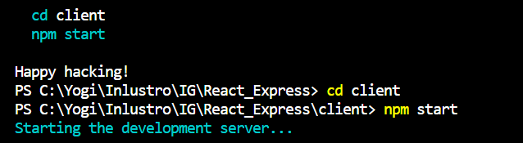
Steps to run react app
Change directory to newly created react app
npm start

Slide 46
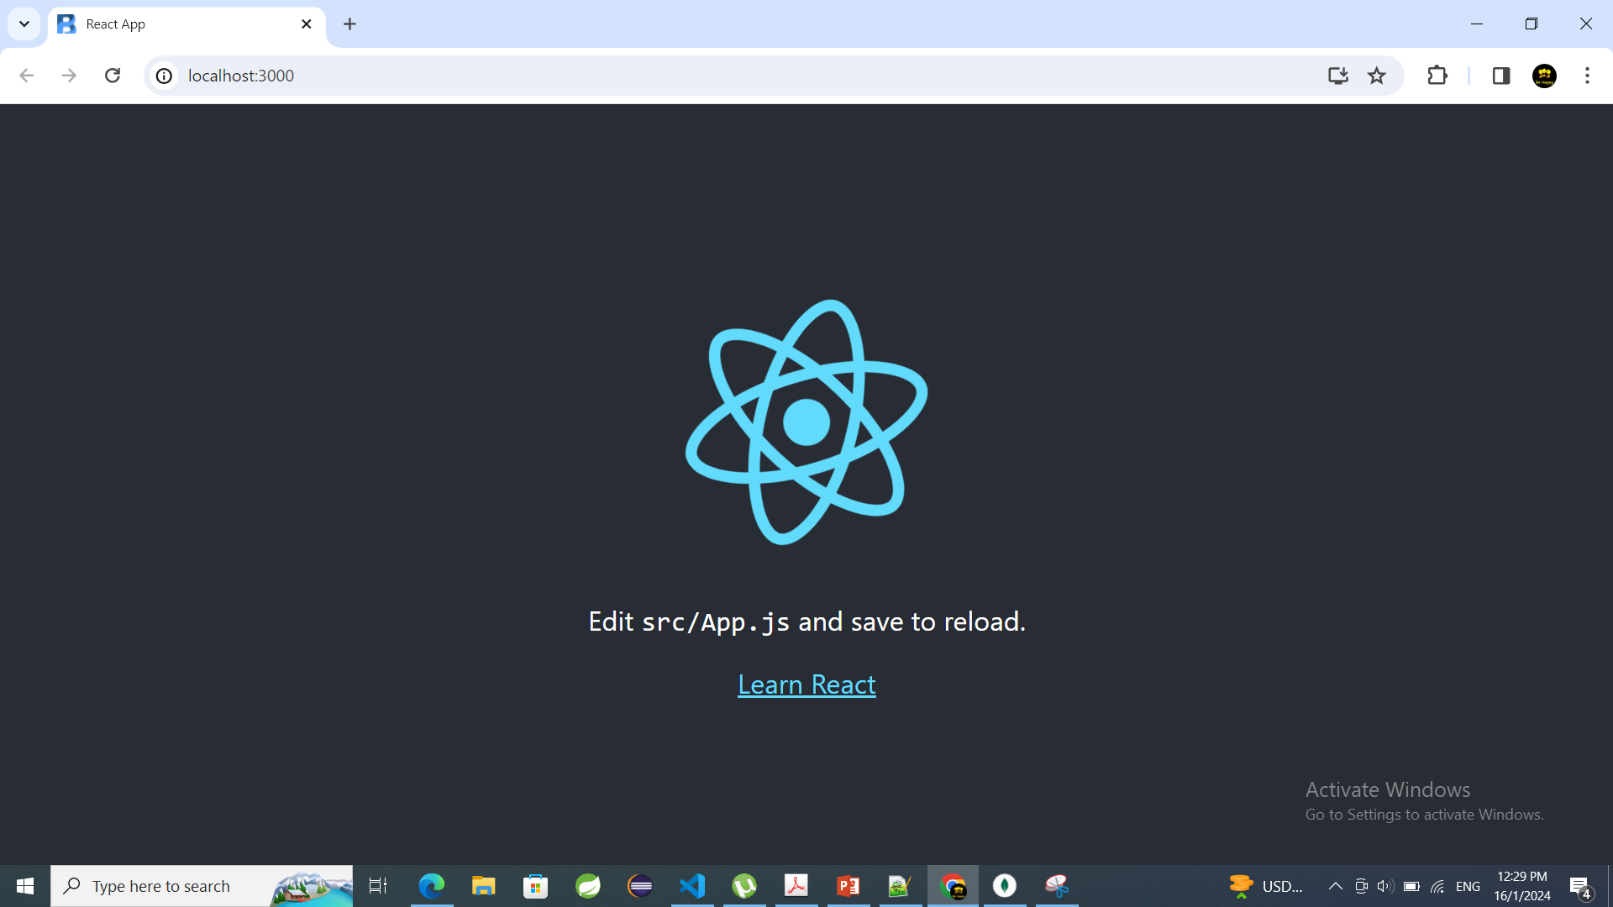

Slide 47
We have created and started react app successfully

Slide 48
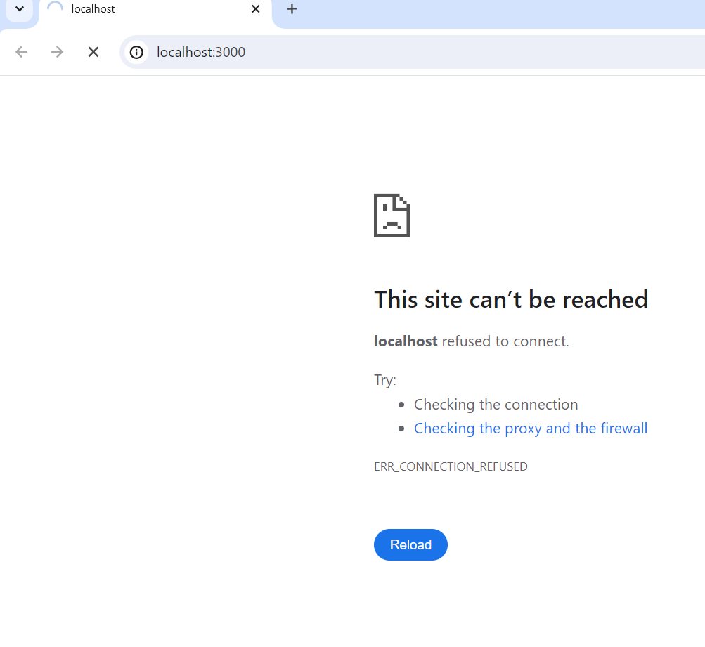
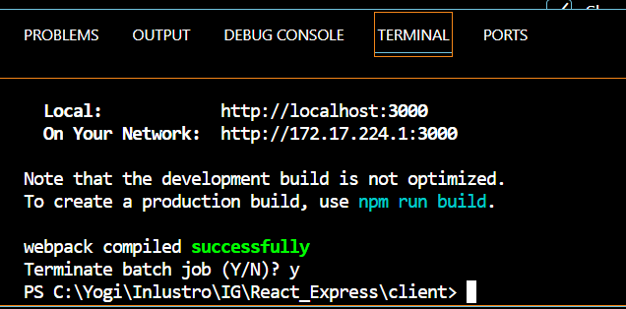
Terminate react app
Cntrl+c

Slide 49
Steps to create Express app
Open directory to create
In terminal type command
npx express-generator api(app name)
Command to run express api
cd api(app name)
npm install (command to install dependencies)
npm start

Slide 50
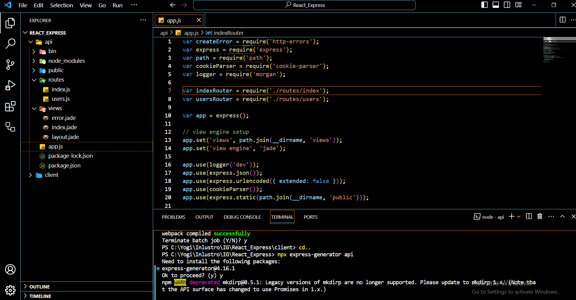

Slide 51
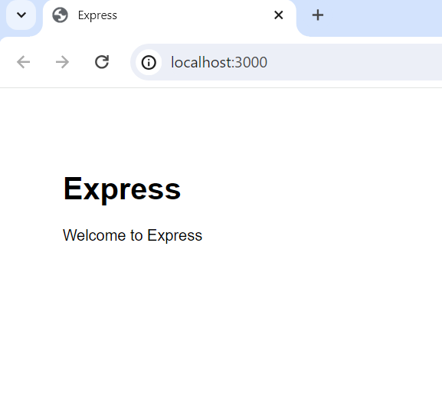
Express

Slide 52
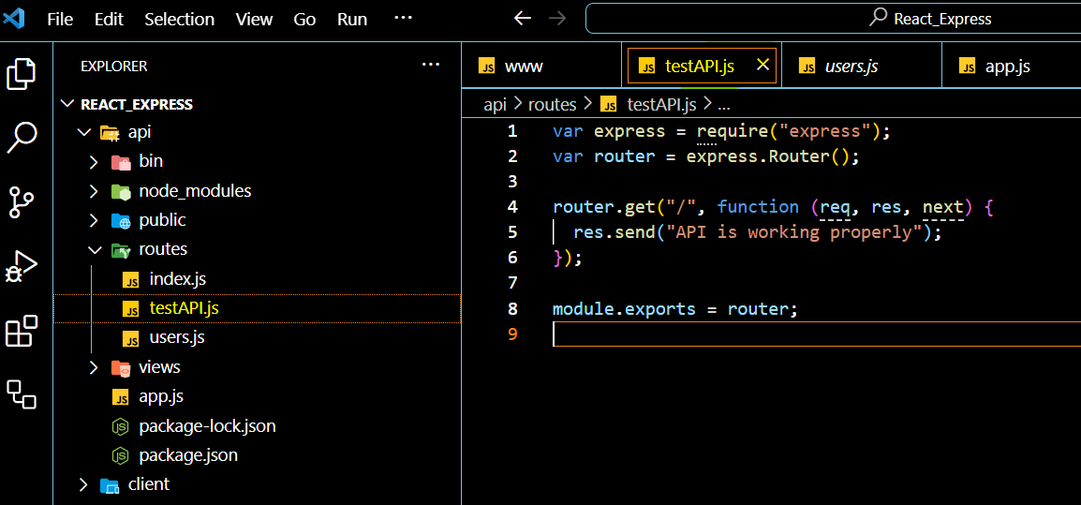
Configuring a new route in the Express API

Slide 53
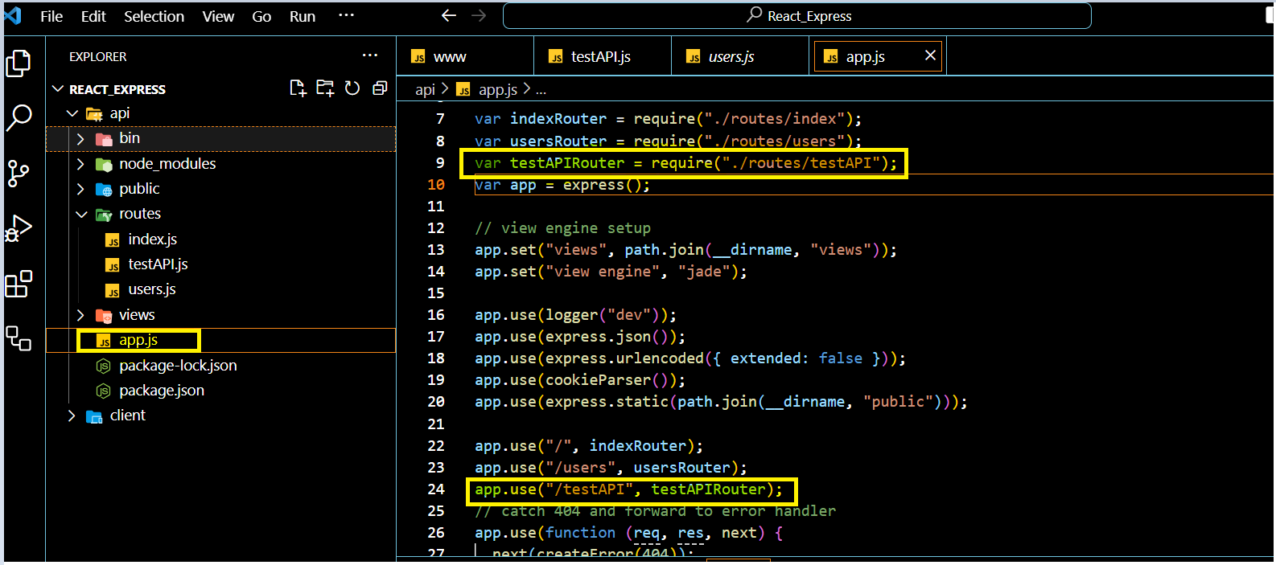
To use new route require new route in app.js

Slide 54
Connecting the React Client to the Express API
Refer demo

